Slide 1

Assembler-Project coshInv Computer Architecture Practical Training (ERA Praktikum)
Group 53: Adrian Kögl – Project Manager
Daniel Osipishin – Documentation Manager
Marc Sinner – Presentation Manager

Slide 2
Structure
Assignment details
Solution approach
Functionality
Precision
Demonstration
Emergence of the solution
Project course
Decisions

Slide 3
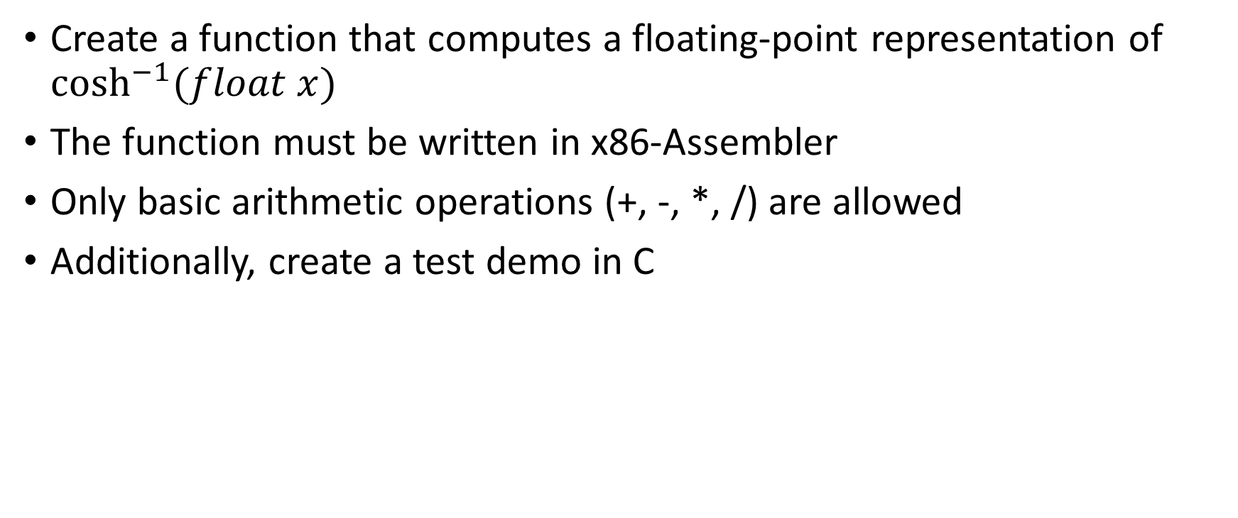
Assignment details
Create a function that computes a floating-point representation of $\cosh^{−1}{(float x)}$
The function must be written in x86-Assembler
Only basic arithmetic operations (+, -, *, /) are allowed
Additionally, create a test demo in C

Slide 4
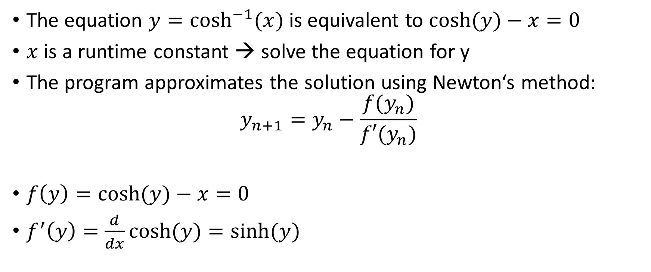
Solution approach
The equation $y=\cosh^{−1}{(x)}$ is equivalent to $\cosh{(y)}−x=0$
$x$ is a runtime constant → solve the equation for y
The program approximates the solution using Newton‘s method: $y_{n+1}=y_{n}−\frac{f(y_{n})}{f′(y_{n})}$
$f\left(y\right)=\cosh{(y)}−x=0$
$f^{′}\left(y\right)=\frac{d}{dx}\cosh{(y)}=\sinh{(y)}$
Notes:
x is a runtime constant

Slide 5
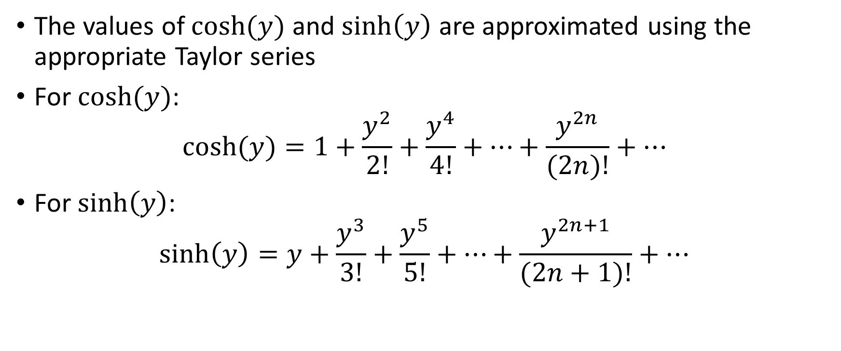
Solution approach
The values of $\cosh{(y)}$ and $\sinh\left(y\right)$ are approximated using the appropriate Taylor series
For $\cosh{(y)}$: $\cosh{(y)}=1+\frac{y^{2}}{2!}+\frac{y^{4}}{4!}+…+\frac{y^{2n}}{(2n)!}+…$
For $\sinh\left(y\right)$: $\sinh\left(y\right)=y+\frac{y^{3}}{3!}+\frac{y^{5}}{5!}+…+\frac{y^{2n+1}}{(2n+1)!}+…$

Slide 6
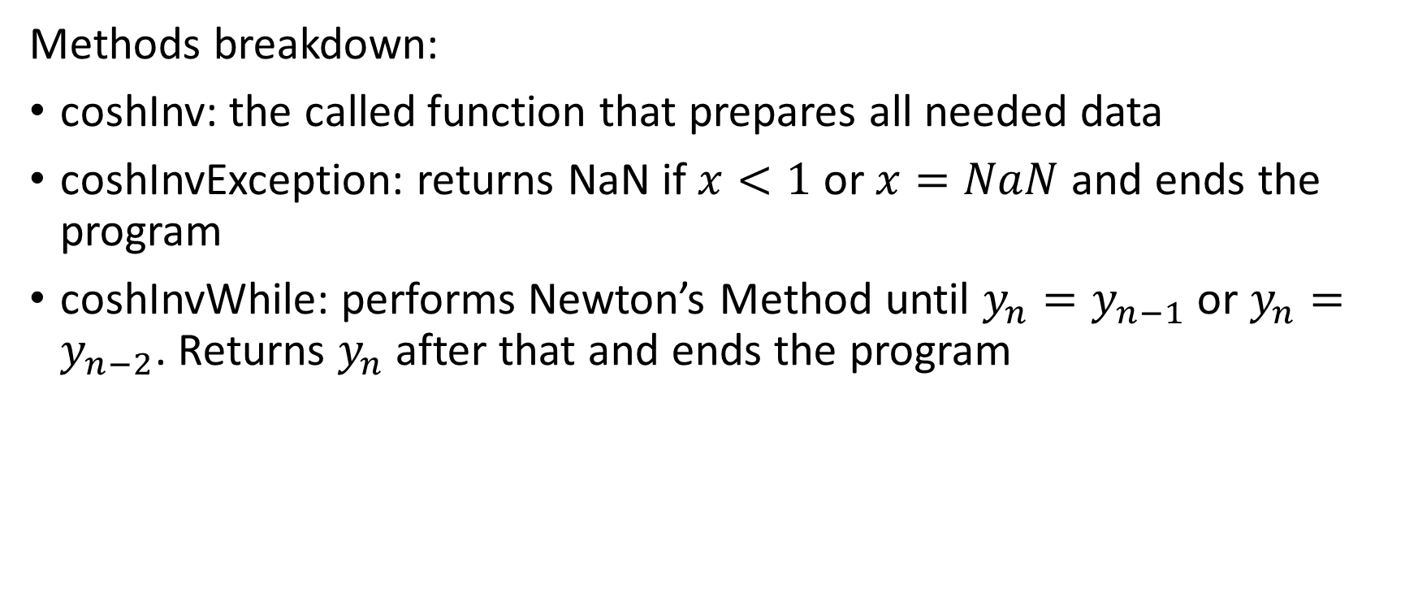
Functionality
Methods breakdown:
coshInv: the called function that prepares all needed data
coshInvException: returns NaN if $x<1$ or $x=NaN$ and ends the program
coshInvWhile: performs Newton’s Method until $y_{n}=y_{n−1}$ or $y_{n}=y_{n−2}$. Returns $y_{n}$ after that and ends the program

Slide 7
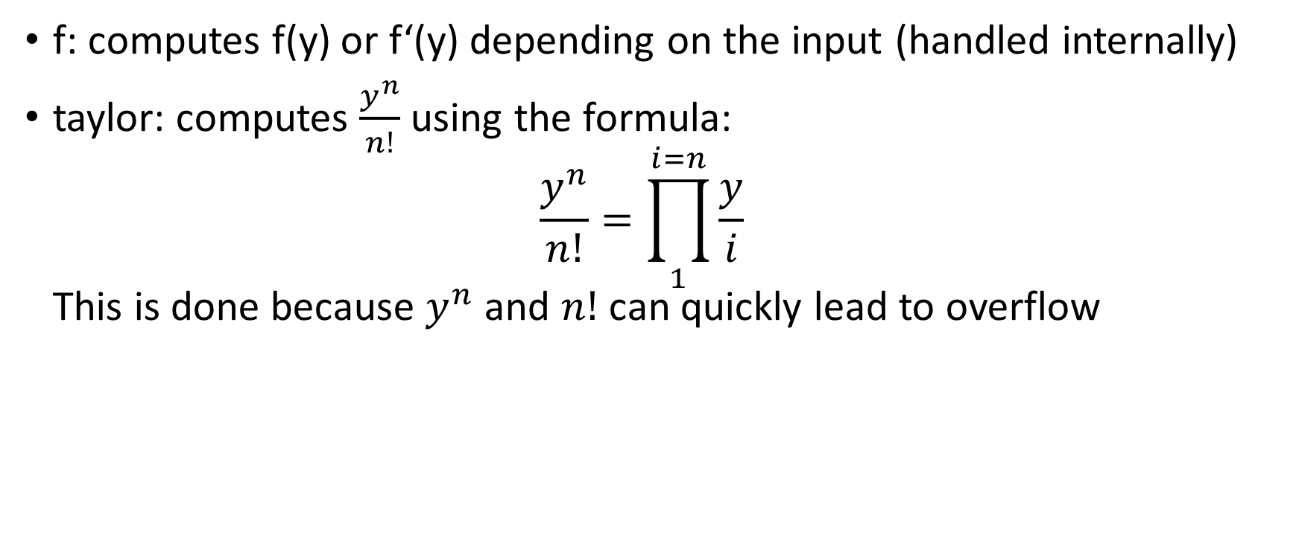
Functionality
f: computes f(y) or f‘(y) depending on the input (handled internally)
taylor: computes $\frac{y^{n}}{n!}$ using the formula: $\frac{y^{n}}{n!}=\prod_{1}^{i=n}{\frac{y}{i}}$ This is done because $y^{n}$ and $n!$ can quickly lead to overflow
Notes:
Formula to avoid overflow

Slide 8
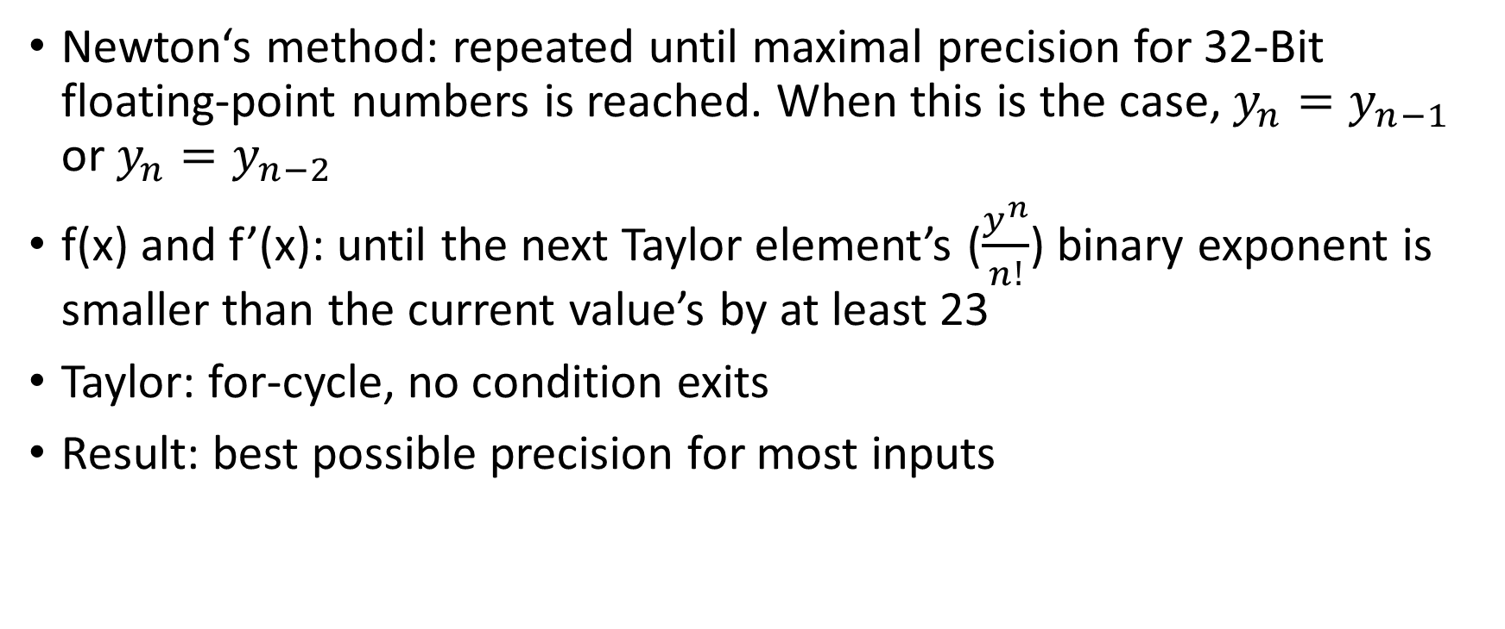
Precision
Newton‘s method: repeated until maximal precision for 32-Bit floating-point numbers is reached. When this is the case, $y_{n}=y_{n−1}$ or $y_{n}=y_{n−2}$
f(x) and f’(x): until the next Taylor element’s ($\frac{y^{n}}{n!}$) binary exponent is smaller than the current value’s by at least 23
Taylor: for-cycle, no condition exits
Result: best possible precision for most inputs

Slide 9
Allow us to demonstrate…

Slide 10
Emergence of the solution
f

Slide 11
Project course
f

Slide 12









Decisions
x86
Notes:
No direct RAM usage – only stack
No SVN internally – only git
No x64 – only x86
Only for Windows

